Slide 1

18CSE392T – Machine Learning I
Department of Data Science and Business Systems

Slide 2
Machine Learning Types
Supervised
Unsupervised
Reinforcement

Slide 3
Supervised learning

Slide 4
Agenda
Definition
Data
Categories
Supervision of training
Applications
Algorithms

Slide 5
Supervised Learning
Labelled Data
Direct Feedback
Predict outcome / future
1
2
3

Slide 6
Definition
Supervised ML is a method in which we teach the machines using labelled data.
In other words.....
The main goal in supervised learning is to learn a model from labeled training data that allows us to make predictions about unseen or future data.

Slide 7
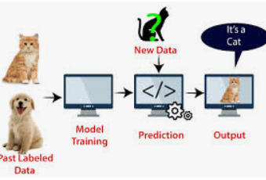
Data
Labelled Input Data
Labelled Output Data

Slide 8
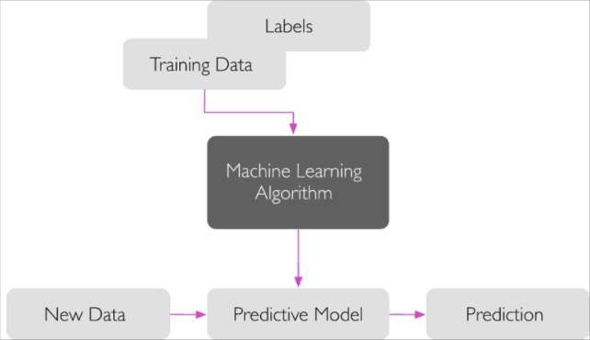
Supervision of Training
Needs External Supervision from training data

Slide 9
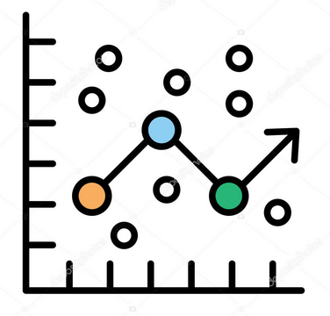
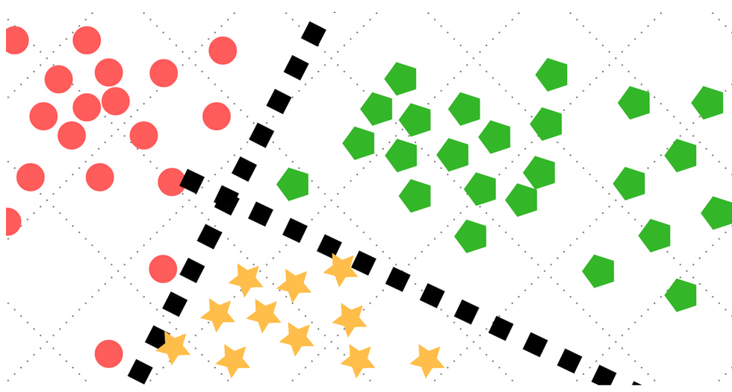
Categories
Classification
Input : Discrete
Regression
Input : continuous

Slide 10
Applications (Supervised learning)

Slide 11
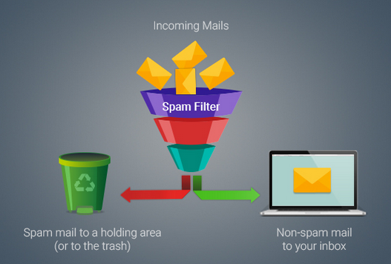
Email Spam Filtering
A corpus of labeled emails, emails that are correctly marked as spam or not-spam
To predict whether a new email belongs to either of the two categories

Slide 12
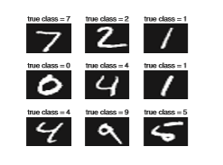
Handwriting Character recognition
Multiclass classification task

Slide 13

Predicting Real Estate Price

Slide 14
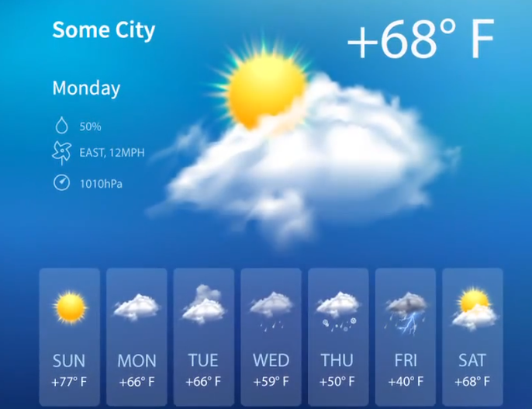
Weather Forecasting
Weather forecasting is a prediction of what the weather will be like in an hour, tomorrow, or next week.

Slide 15
Algorithms
Linear Regression
Logistic Regression
K- Nearest Neighbor
Bayesian Classification
Decision Trees
Support Vector Machine (SVM)
Random Forest

Slide 16


